Slide 1
Preplanning for Your Video: Storyboarding

Slide 2
What is a storyboard?
A visual outline in a series of illustrations detailing what a film, an animation, a game or a multimedia project will look like when completed.
“A highly interactive, visual process that combines both creative and analytical thinking, also known as ‘displayed thinking.’” - Thunderbolt Thinking, Grace McGartland

Slide 3
Elements of a storyboard
Sketches of what is happening during the current shot
Captions with description of what is occurring on the screen
Length of time of shot
Order of sequence of shots

Slide 4
What does a storyboard look like?

Slide 5
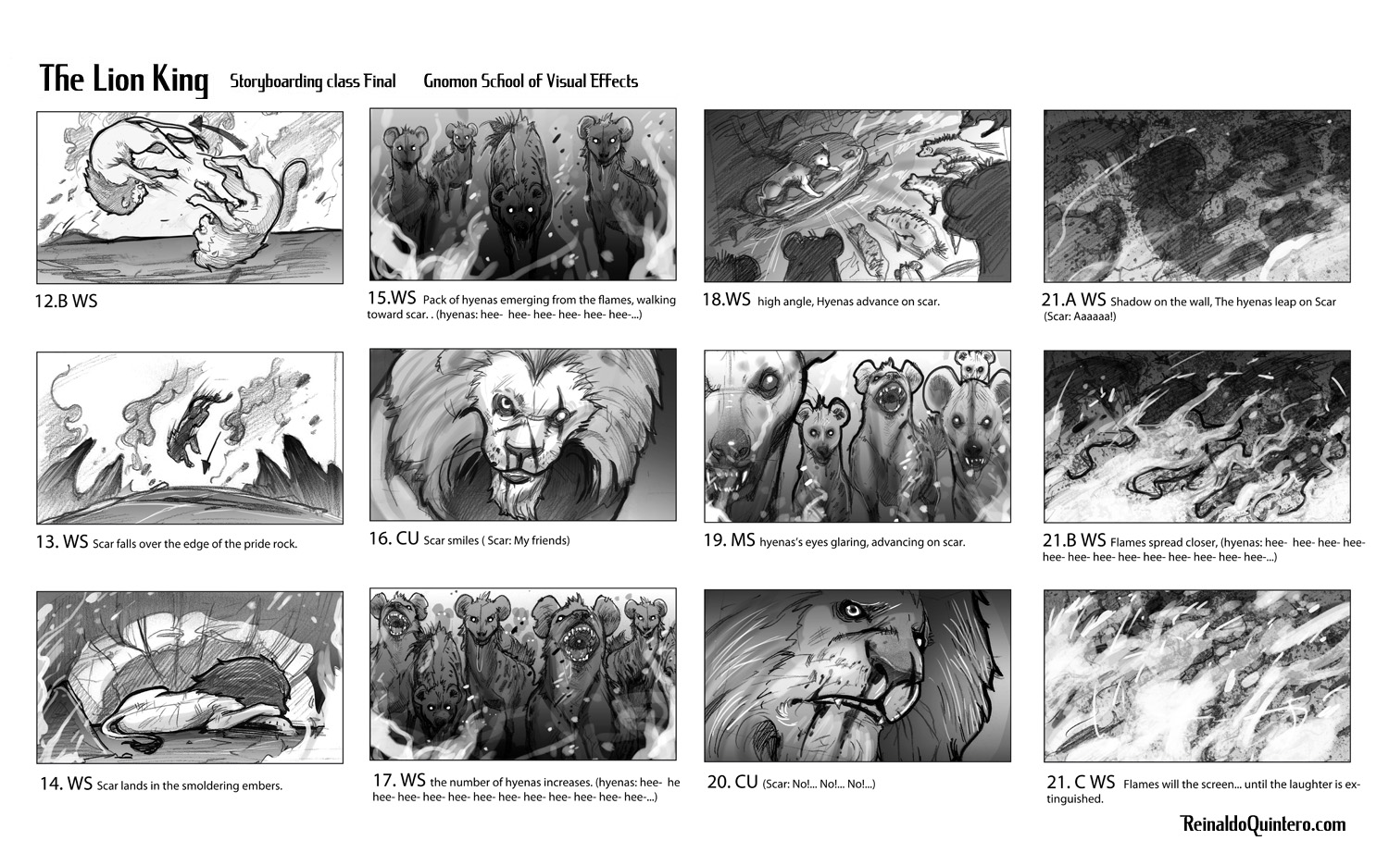

Slide 6
What are storyboards used for?
Movies
TV Shows – Cartoons especially
Music Videos
Commericals

Slide 7
Storyboard 101
Who: Anyone who can visualize a story can create a storyboard, one that can be edited and polished by an expert.
What: Series of illustrations detailing what a film, an animation, a game or a multimedia project will look like when completed.
When: In 1928, Disney Animation Studios created storyboards for the first Mickey Mouse cartoon shorts. Storyboards have been used ever since then by filmmakers and animators the world over.
Alfred Hitchcock championed storyboards. He used them in all his films and claimed that once he had one, he never needed to touch a camera during filming.

Slide 8
Storyboard 101 Cont’d
How: The rubric of sequential art – a series of illustrations that produces a story that is instantly comprehensible. What transpires between each illustration is as important as the action depicted within them. The audience instinctively grasps the missing details.
Why: Easier and faster to read than scripts. Because they are closest to a finished project, they assist a production crew by pointing up troublesome issues which can be corrected early, thus saving time and money. Directors and project leaders can maintain creative control over the final product.
Where: Virtually every box office hit, successful game and critically acclaimed multimedia project started as a storyboard.

Slide 9
Benefits of Storyboarding
Visual
Reduces the time spent on unfocused, undirected discussion
Allows everyone to share ideas equally
Action-oriented, intense, and engages everyone in the process
Especially helpful in generating alternatives and making decisions about them
Demands a high degree of participation

Slide 10
Why should I make a storyboard?
Help you plan your video out shot by shot.
You can make changes to your storyboard before you start shooting, instead of changing your mind later.
You will also be able to talk about your video and show your storyboard to other people to get feedback on your ideas.

Slide 11
What information should your storyboard have?
Sketch of what is happening on screen during that shot
Description of what action is occurring
Panels numbered in sequential order

Slide 12
Storyboard Vocabulary
CLOSE-UP SHOT: A close range of distance between the camera and the subject.
DISSOVLE: A transition between two shots, where one shot fades away and simultaneously another shot fades in.
FADE - A transition from a shot to black where the image gradually becomes darker is a Fade Out; or from black where the image gradually becomes brighter is a Fade In.
HIGH CAMERA ANGLE: A camera angle which looks down on its subject making it look small, weak or unimportant.
JUMP CUT: A rapid, jerky transition from one frame to the next, either disrupting the flow of time or movement within a scene or making an abrupt transition from one scene to another.
LEVEL CAMERA ANGLE: A camera angle which is even with the subject; it may be used as a neutral shot.
LONG SHOT: A long range of distance between the camera and the subject, often providing a broader range of the setting.
LOW CAMERA ANGLE: A camera angle which looks up at its subject; it makes the subject seem important and powerful.
PAN: A steady, sweeping movement from one point in a scene to another.
POV (point of view shot): A shot which is understood to be seen from the point of view of a character within the scene.
REACTION SHOT- 1.: A shot of someone looking off screen. 2.: A reaction shot can also be a shot of someone in a conversation where they are not given a line of dialogue but are just listening to the other person speak.
TILT: Using a camera on a tripod, the camera moves up or down to follow the action.
ZOOM: Use of the camera lens to move closely towards the subject.

Slide 13
Videos
http://www.youtube.com/watch?v=LgDwNxGIuCQ How-To
http://www.youtube.com/watch?v=3xwonyZdhgs Monsters, Inc. Before/After
http://www.youtube.com/watch?v=QOeaC8kcxH0&feature=related Toy Story

Slide 14
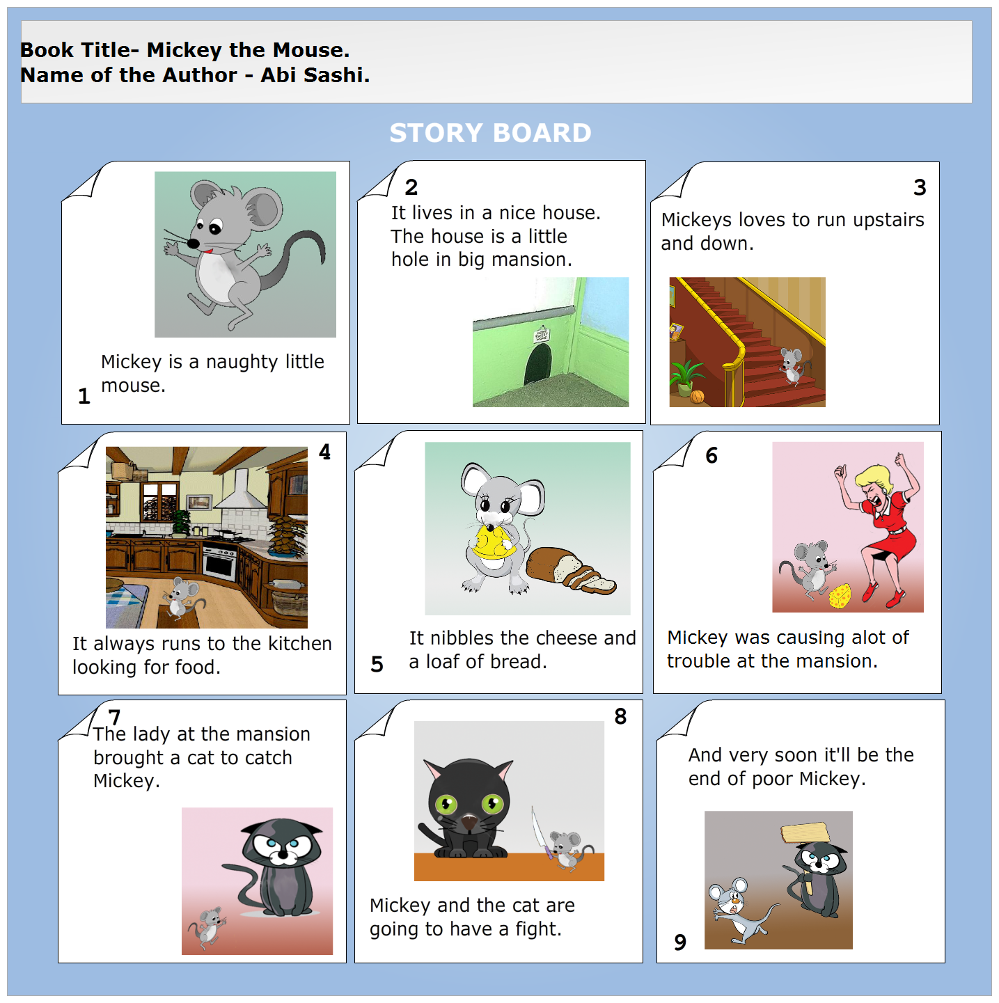
More Examples

